Slide 1
Train new font for Optical Character Recognition

Slide 2
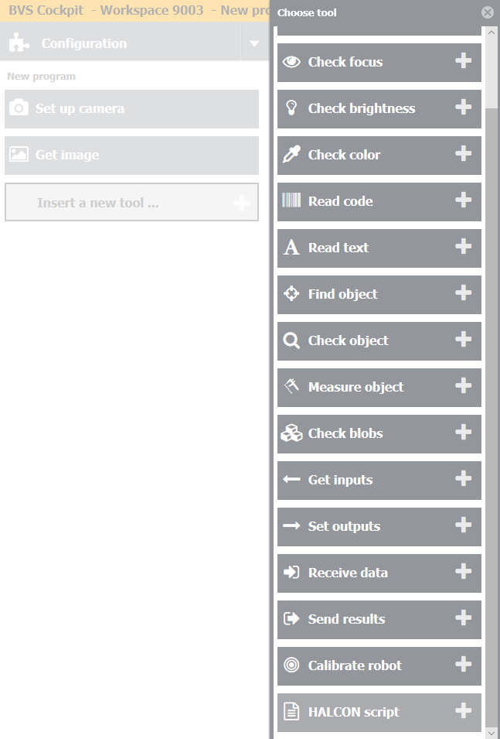
Step 1
Add new tool – Halcon Script – in your inspection program.

Slide 3
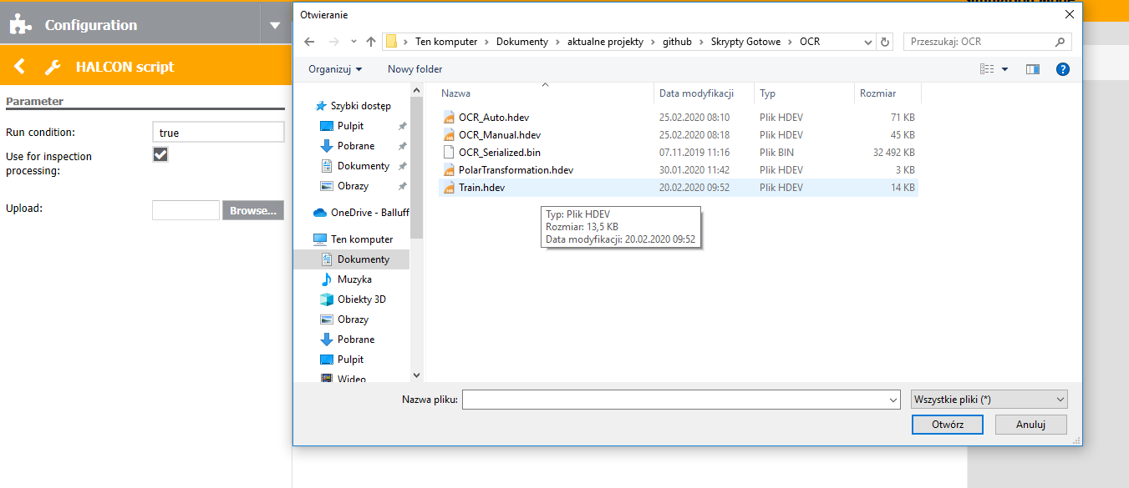
Step 2
Click „Browse” and choose „Train.hdev” file.

Slide 4
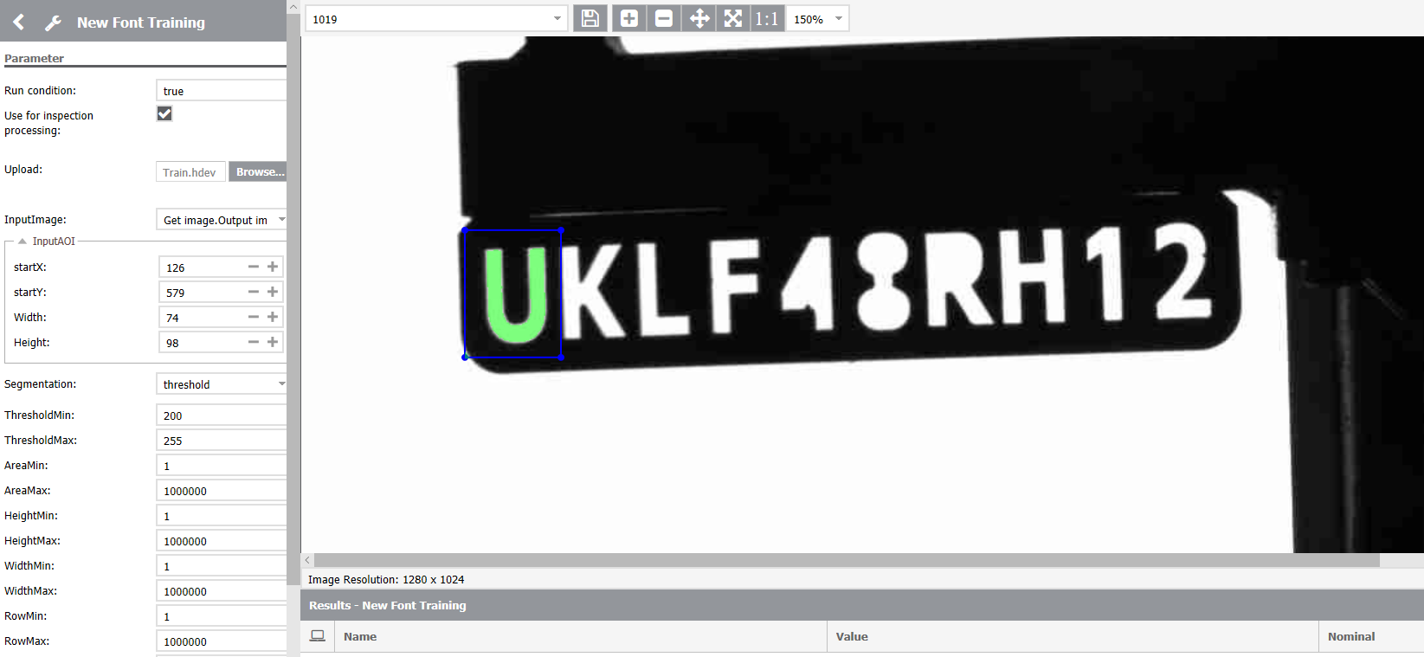
Step 3
Set the AOI to the character that you want to train.

Slide 5
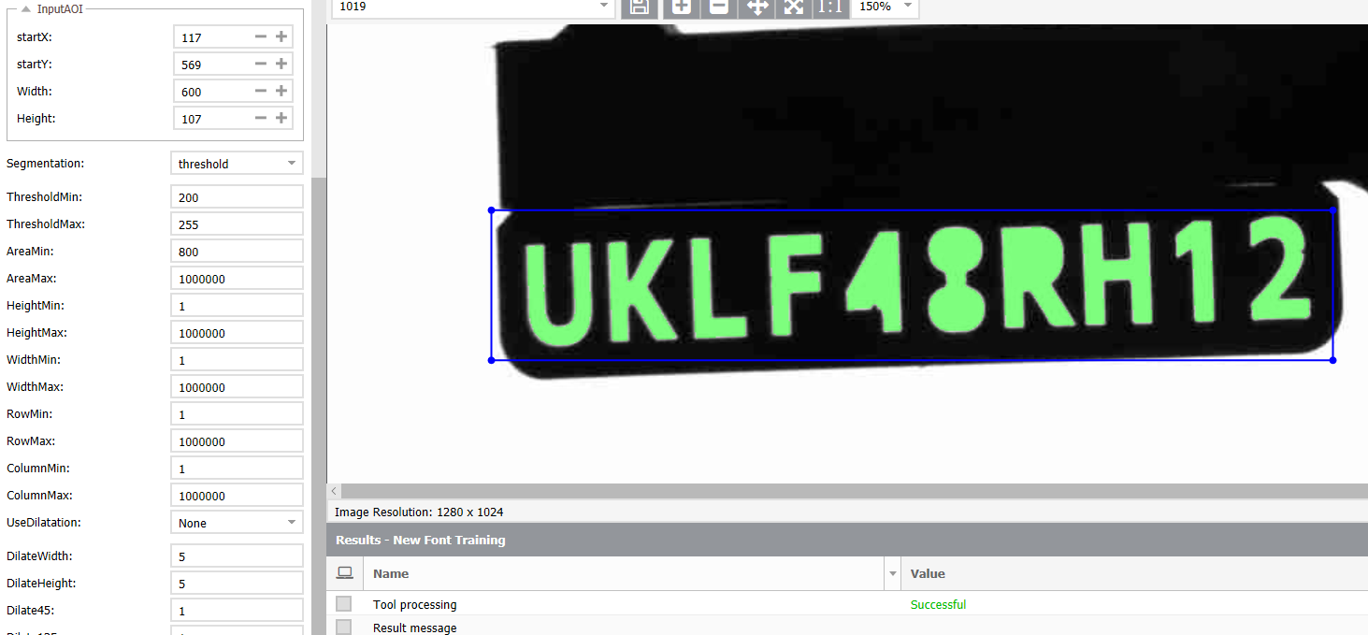
Step 3
It is also possible to set the AOI to bigger amount of characters.

Slide 6
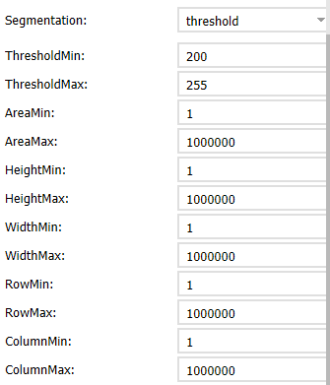
Step 4
Adjust segmentation parameters:
ThresholdMin – minimum value for threshold
ThresholdMax – maximum value for threshold
AreaMin – minimum value for character’s area
AreaMax – maximum value for character’s area
HeightMin – minimum value for character’s height
HeightMax – maximum value for character’s height
WidthMin – minimum value for character’s width
WidthMax – maximum value for character’s width
RowMin – minimum value for character’s row position
RowMax – minimum value for character’s row position
ColumnMin – minimum value for character’s column position
ColumnMax – maximum value for character’s column position

Slide 7
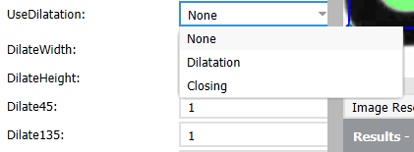
Step 5
Choose whether to use Dilatation, Closing or None of them.
If you choose Closing you can set following parameters:
DilateHeight – closing in vertical direction
DilateWidth – closing in horizontal direction
Dilate45 – closing in 45° direction
Dilate135 – closing in 135° direction
If you choose Dilatation you can set following parameters:
DilateHeight – dilation in vertical direction
DilateWidth – dilation in horizontal direction
If you choose None „Dilate…” parameters will not change anything.

Slide 8

Step 6
Set Path in which trained character and new font will be saved:
For BVS Cockpit PC version you can set any path you want (for example: "C:/Users/User/Desktop/„).
For BVS Cockpit in SVC you have to set path in “/data/icsServer/share/images/”
For BVS Cockpit in SC you have to set path in “../images/”
Be sure that the folder exists.
Be sure that there are no blank spaces in your path.
It’s better to type in the path in the box from scratch that copying it because it may cause various problems.

Slide 9
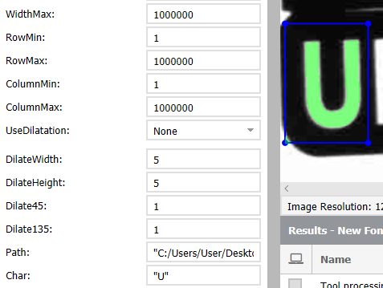
Step 7
Write your character in Char textbox (between “ “).
Be sure to press “enter” so that the textbox will be updated.

Slide 10

Step 7
If you set the AOI to bigger amount of characters you have to write all of the characters.

Slide 11
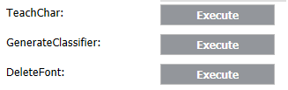
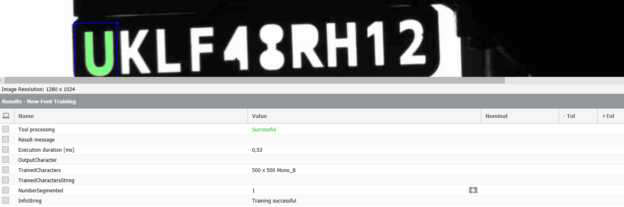
Step 8
Click “Execute” on the right of “TeachChar”. New character should be successfully added to training file – it will be indicated in InfoString variable.

Slide 12
Step 8
If you will see message „Number of segmented characters not equal to number of entered characters” it means that the number of characters in AOI does not match with the amount of character written in Char box. None of the characters will be trained.
The number of segmented characters in AOI can be seen in NumberSegmented variable.

Slide 13
Step 9
Repeat steps from 3 to 8 until you teach all of your characters.
It is recommended to teach one character several times each on different image.

Slide 14
Step 10
Click “Execute” on the right of “GenerateClassifier”. This will generate new font for OCR (MLP based model).

Slide 15
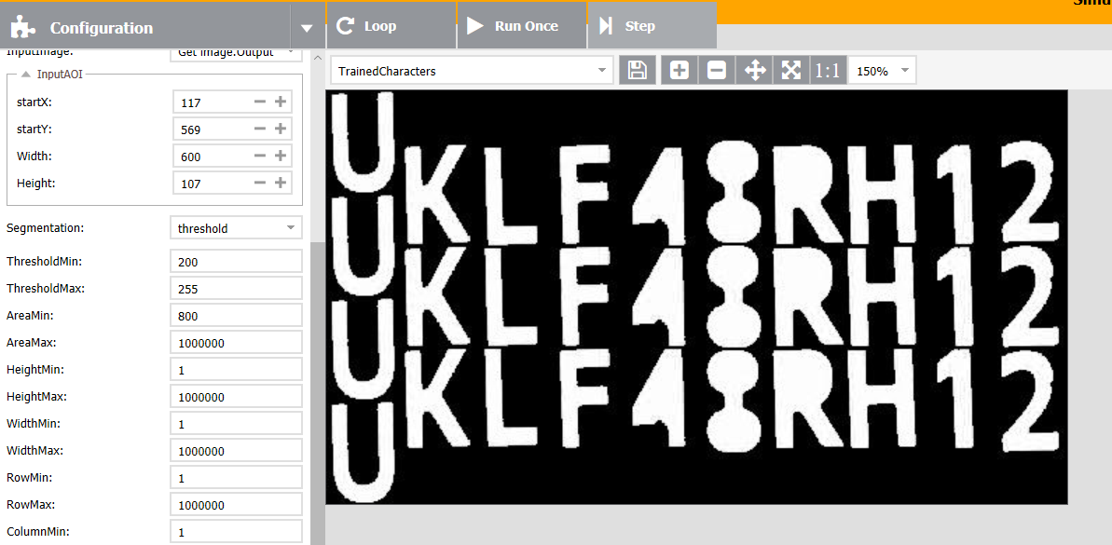
Step 10
If you want to see all of the trained characters you can choose TrainedCharacters image. You have to click „Run Once” to refresh the visualization.
Different characters will be grouped in coulmns – same characters in rows.

Slide 16
Step 11
If you want to delete your training file and new font file you can click “Execute” on the right of “DeleteFont”.

